Slide 1
QUCS
Quite Universal Circuit Simulator
Jaya Srivastava
QUCS is an integrated circuit simulator, which allows us to setup a circuit with a Graphical User Interface (GUI) and simulate various behaviors of the circuit.
Monday
3 June, 2024

Slide 2
Installation of QUCS
- Download from https://qucs.sourceforge.net/ .
After download, you can extract the contents by clicking on the ZIP file. We recommend that you extract the contents in a folder such as C:\Qucs.
After extracting the files, use the File Explorer to locate C:\Qucs\qucs-0.0.19-win32mingw482-asco-freehdl-adms. You will find the application qucs.bat. Double click on it to start the simulator. It is better to start qucs from qucs.bat than qucs.exe.
The same site i.e. ‘qucs.sourceforge.net’ can be used for installation on MAC laptops as well. Search “qucs download for MAC” to get the respective link.
NOTE: A few setups might be disabled for MAC users.
Alternative for the same: WINE tool
This should be used only if QUCS has some setup disabled.

Slide 3
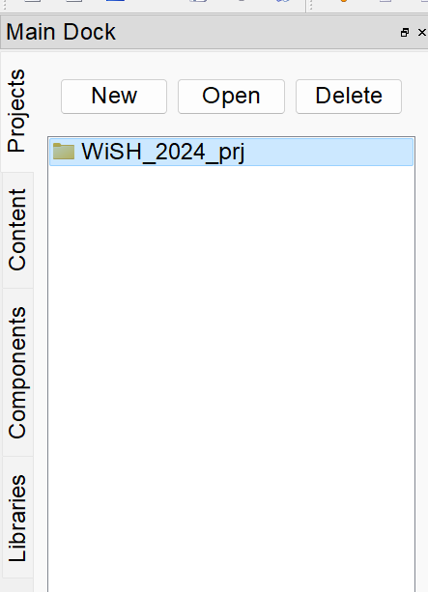
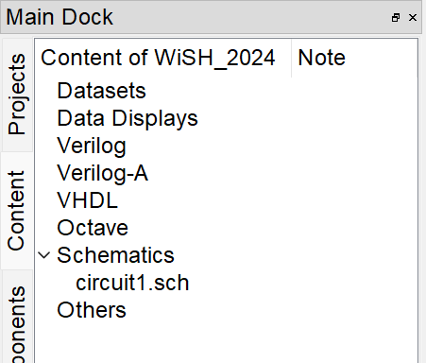
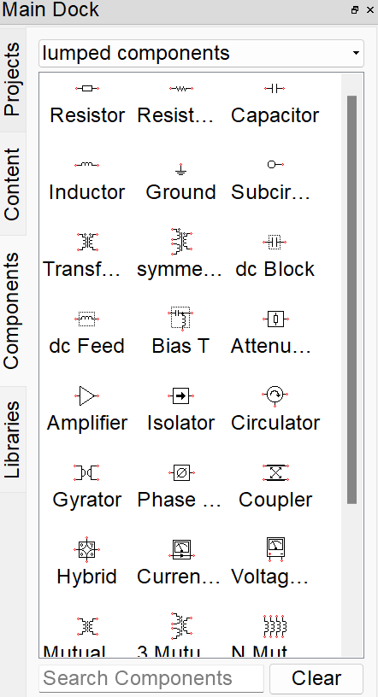
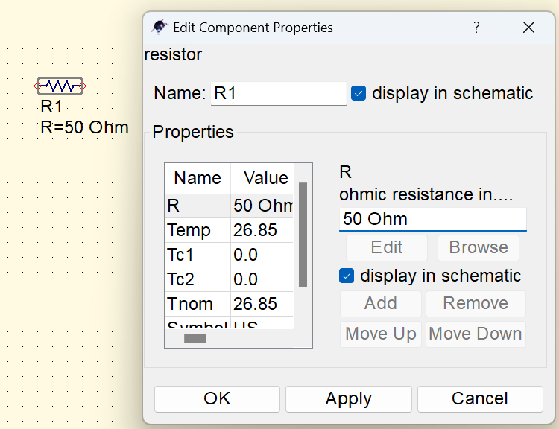
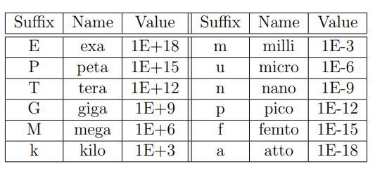
Starting a Project
Go to the Projects section in the main dock, and create a new project there. Now you can make schematics within this project (using File -> New). On double clicking on the newly created project, you will able to see your schematics under the created project.
Components
Resistor
Use the resistor available in lumped components section. Set the ‘R’ value.
Number suffixes

Slide 4
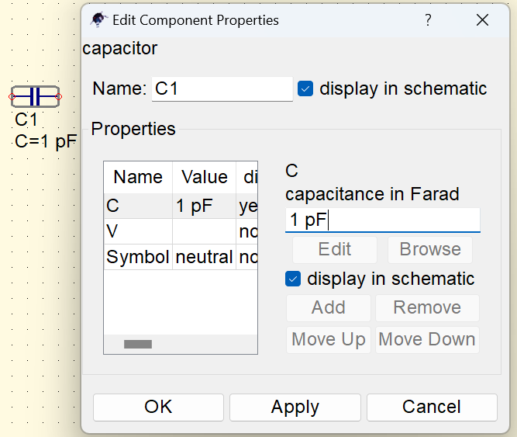
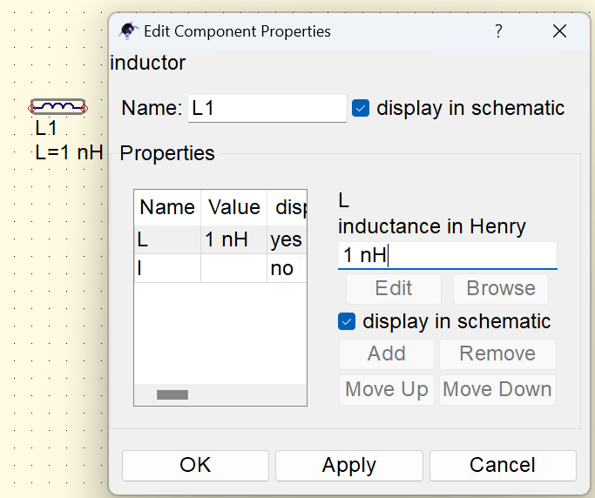
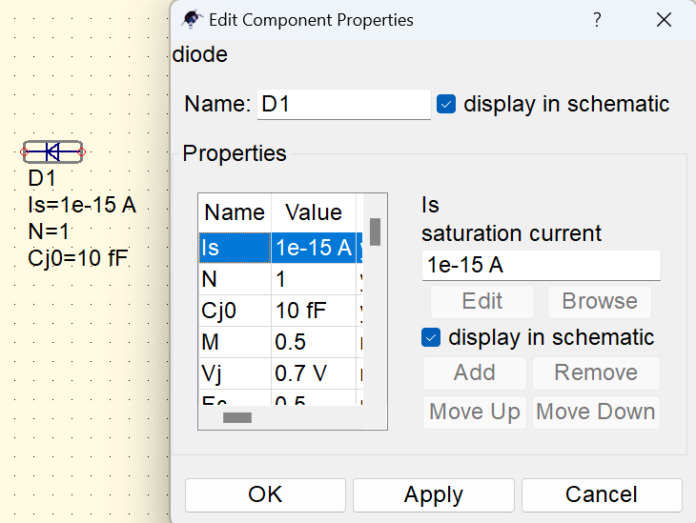
Capacitor
Use the capacitor available in lumped components section. Set the ‘C’ value. You can set the initial voltage of the capacitor if required.
Inductor
Use the inductor available in lumped components section. Set the ‘L’ value. You can set the initial current of the inductor if required.
Diode
Use the diode available in nonlinear components section.

Slide 5
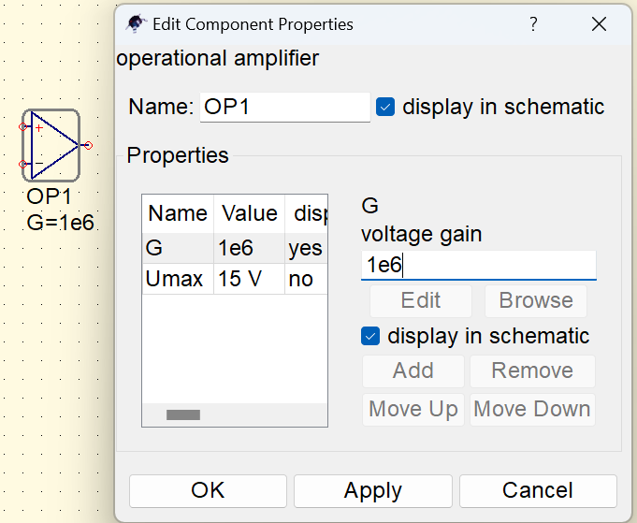
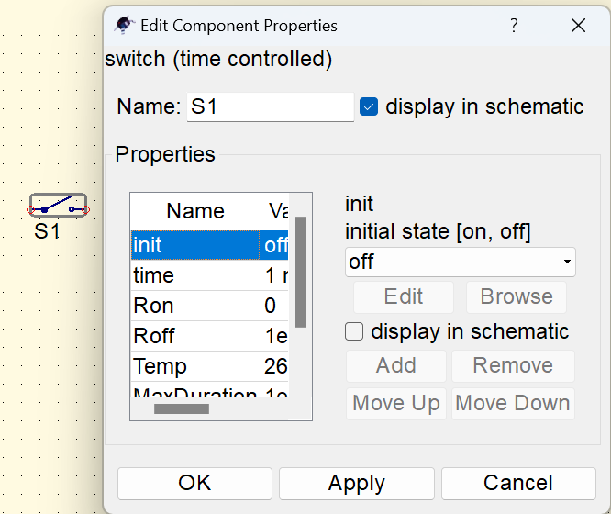
5) Opamp
You can use the Opamp available in nonlinear components section.
6) Switch
It is available in the lumped components section. The initial state of switch
(on/off), time when the state changes (multiple entries can be given separated by semicolon) can be input appropriately.

Slide 6
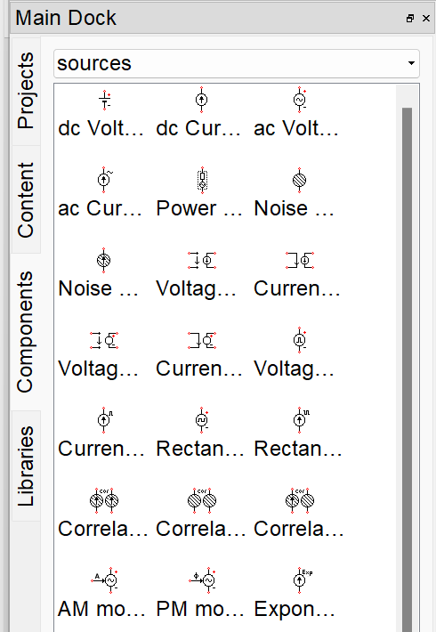
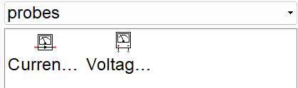
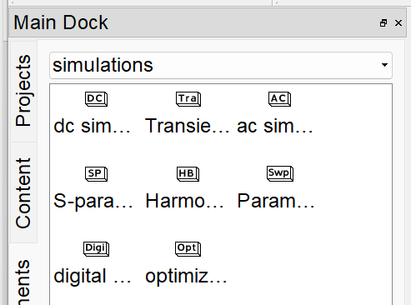
Sources:
Various voltage sources and current sources (AC and DC) are available in the ‘sources’ section.
Probes:
Simulations:
Current probe and voltage probe are available in the ‘probes’ section, which can be connected in series and parallel to sense the current and voltage value respectively.
DC, AC, transient simulations can be done by adding the appropriate simulation block in the schematic from the ‘simulations’ section.

Slide 7
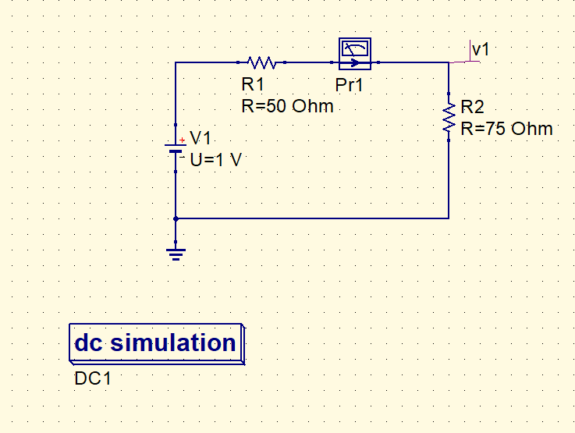
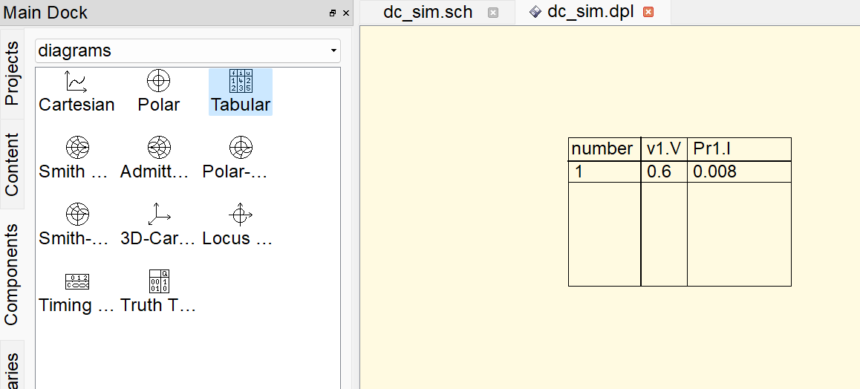
More about simulations
Current probe
DC simulation
Analyzing the outputs of a circuit when excited by a DC voltage source/current source. It is used in calculating operating point, initial conditions in transients, transfer curves etc.
Wire label to check the voltage
DC voltage source
ground
Go to the diagrams section to plot the result.
You can display the result either as a graph or in tabular form.
DC simulation block

Slide 8
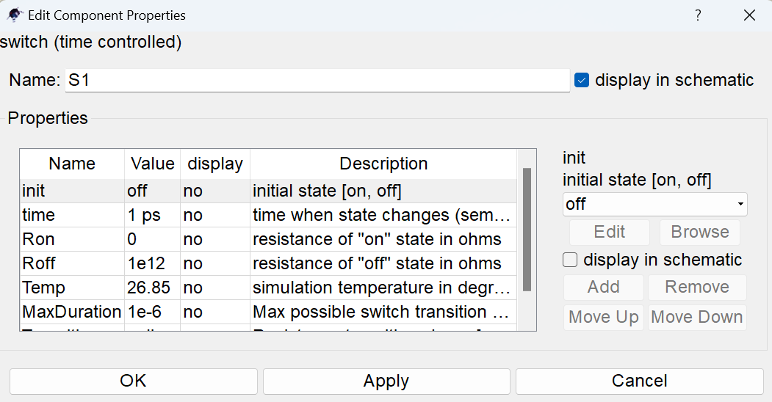
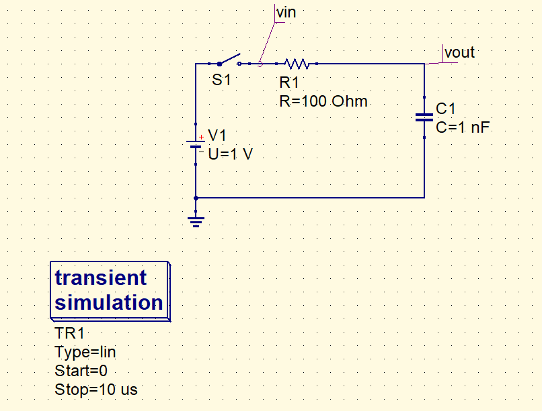
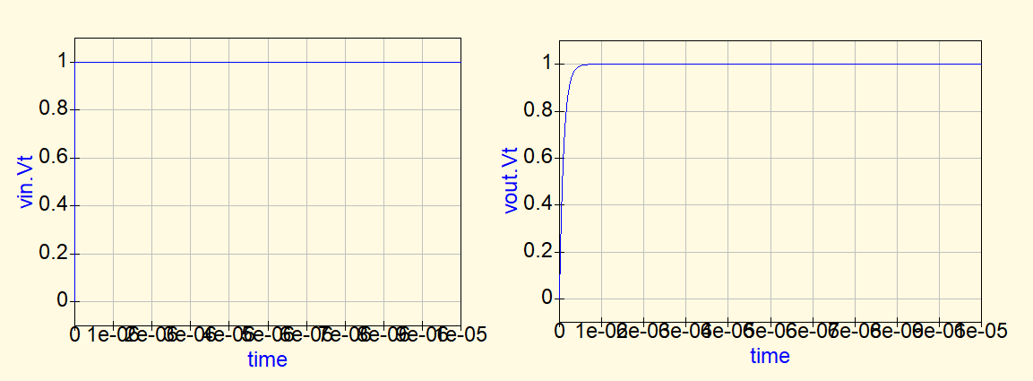
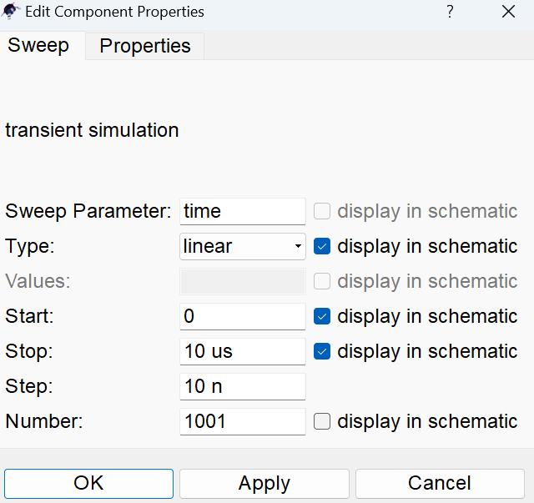
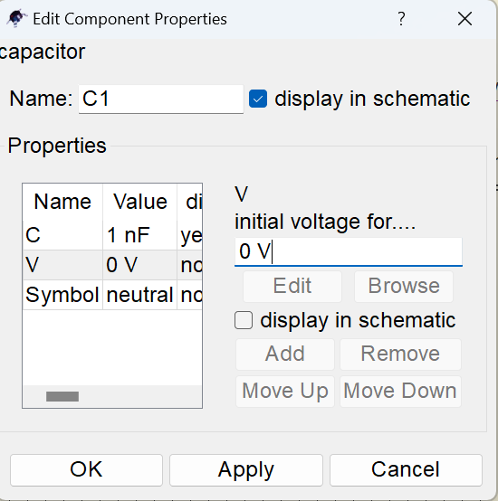
Transient simulation
Transient simulation computes the circuit's response as a function of time. It stops after a set time.
Switch is used to give a step input
Use the cartesian plot method in diagrams section to view the results
Note: Initial voltage of capacitor has to be mentioned as 0 V

Slide 9
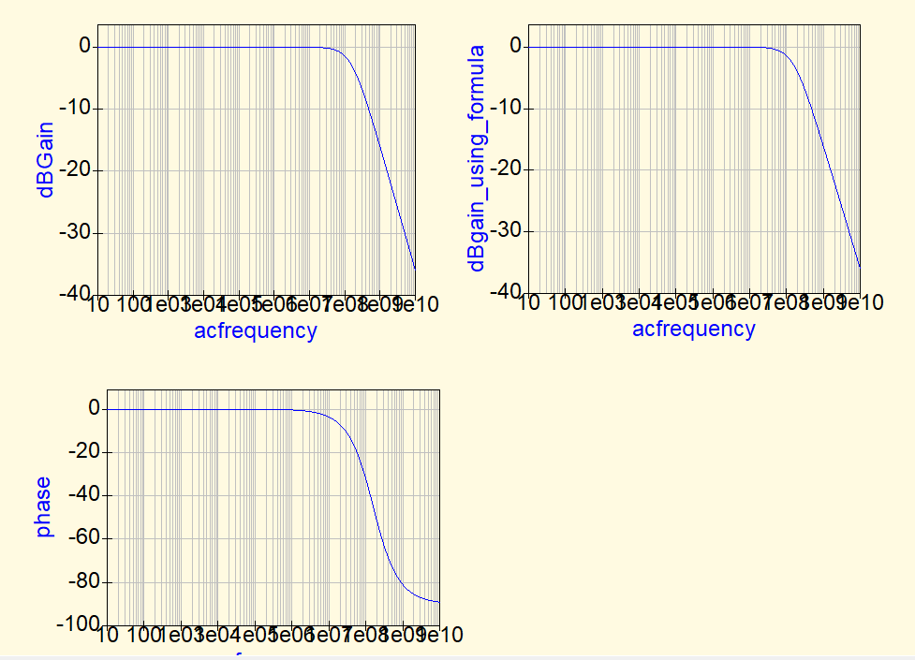
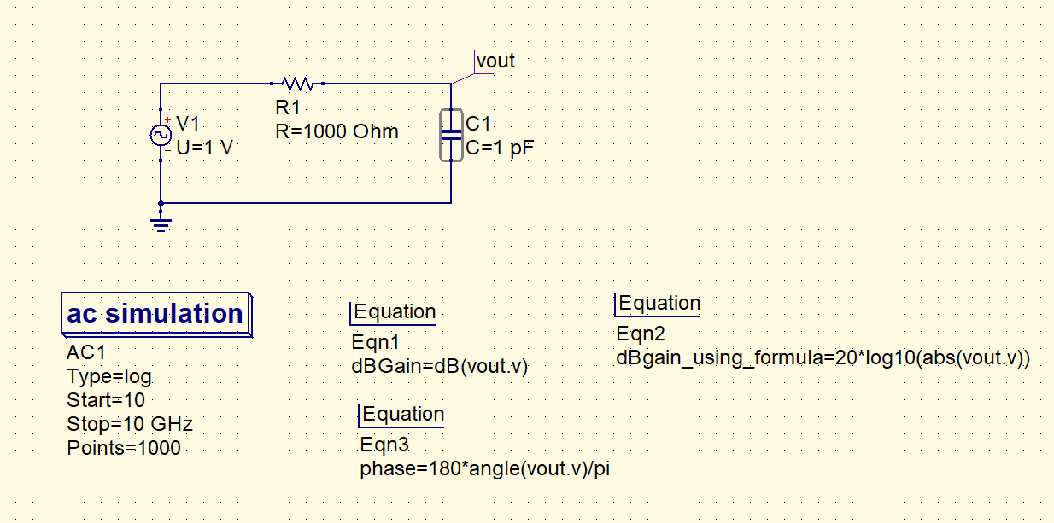
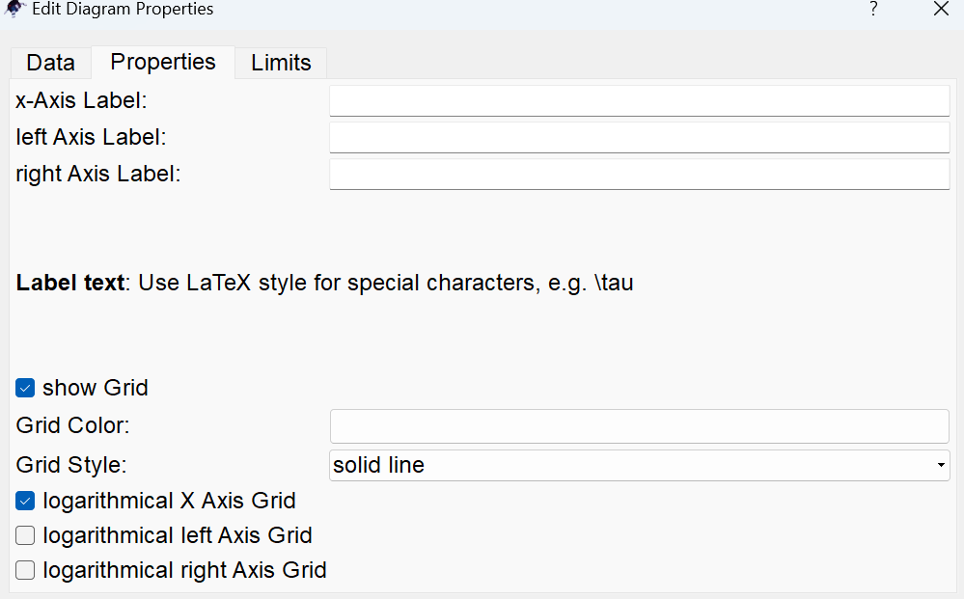
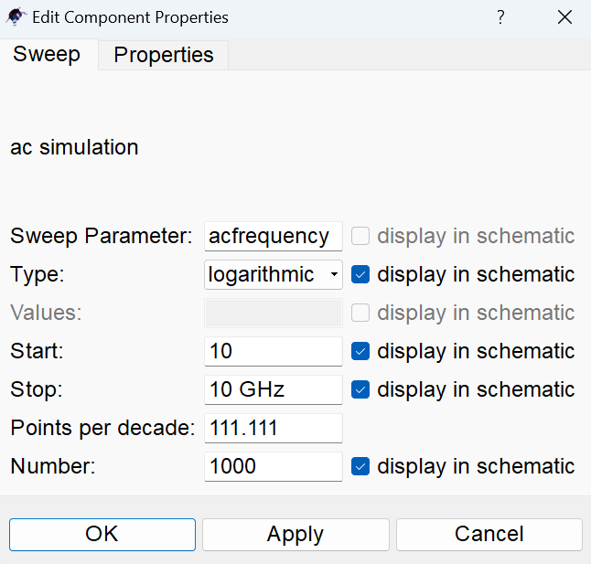
AC simulation
This analysis can be used when we want to check the response of a circuit at a particular frequency, or do a frequency sweep and see how the output varies with frequency.
Results can be plotted using cartesian plot in the diagrams section.
Appropriate equations can be added to plot the gain, phase etc.
The X-axis is set to logarithmic scale

Slide 10
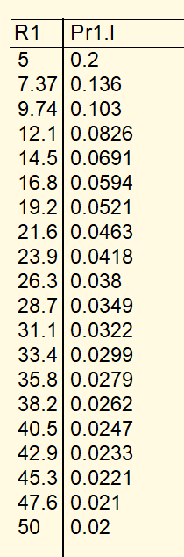
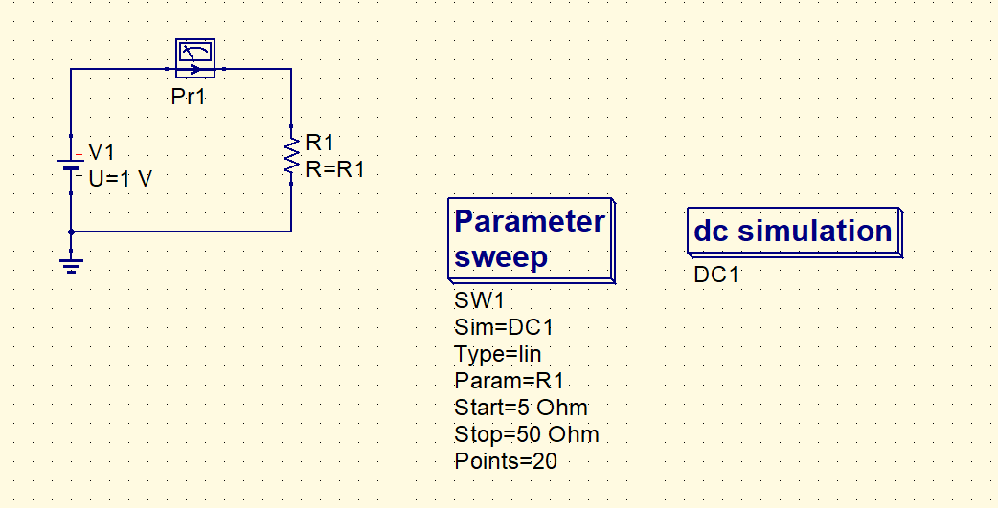
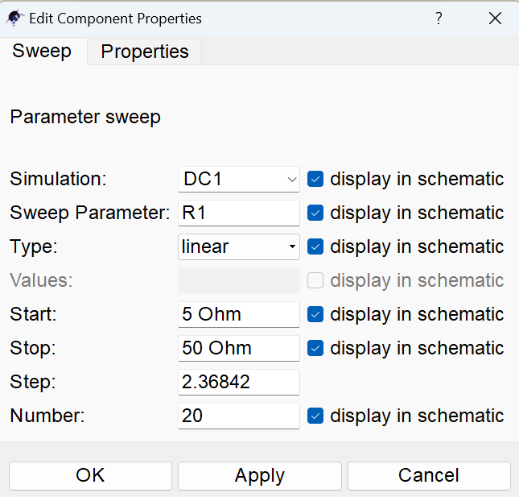
Parametric Sweep
This is used to sweep a particular parameter, to check the effect of it on the circuit response.
Use the parametric sweep block in the simulations section. Before doing a parametric sweep, you need to add the appropriate simulation block as well (DC/AC etc..).
The parameter variable can be swept in a linear/ logarithmic/list fashion.
The results can be viewed in a graphical/tabular fashion.

Slide 11
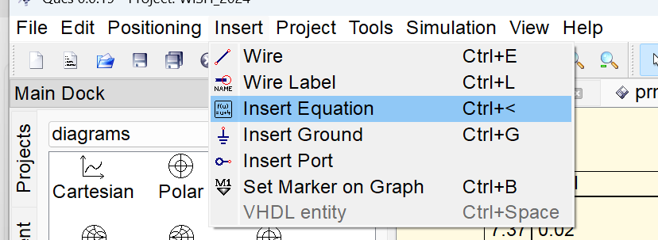
A few other things
Wire label, Marker.
Can be used to label output nodes
Can be used to mark points on graph
2) Equation
- Used to insert equations and plot the results accordingly.
- Pr1.i , Vout.v for current through probe 1 and voltage at node Vout respectively

